Slide 1

INTERNET PROGRAMMING (CSE-326) PROJECT
PROPERTY WEBSITE
Name | Registration Number | Class Roll Number
Pareedula H V Sai Krishna | 12219635 | RKOC26B62
Shaily Sharma | 12219764 | RKOC26B64

Slide 2
Introduction:
Having a Website for your Business is very important. It can help you reach a wider audience and generate more sales. People can look up your website to find your contact details.
A property website can help your customers find the best home their looking to buy or rent. The website can also help customers sell their properties through you.
In this digital age having a website is compulsory to stay ahead of your competition.

Slide 3
The list of various html tags used in the website :
Heading Tags like h1, h2, h3, h4 etc.
<a></a> Tag for anchoring
<img></img> tag for Images
<div></div> for creating containers
<section></section> for creating various sections of the webpage
<p></p> Tags for writing text
<input></input> Tags for taking input from the user.
<li></li> To create lists
And all the major Tags like <main>, <head>, <link> ,<body> etc.

Slide 4
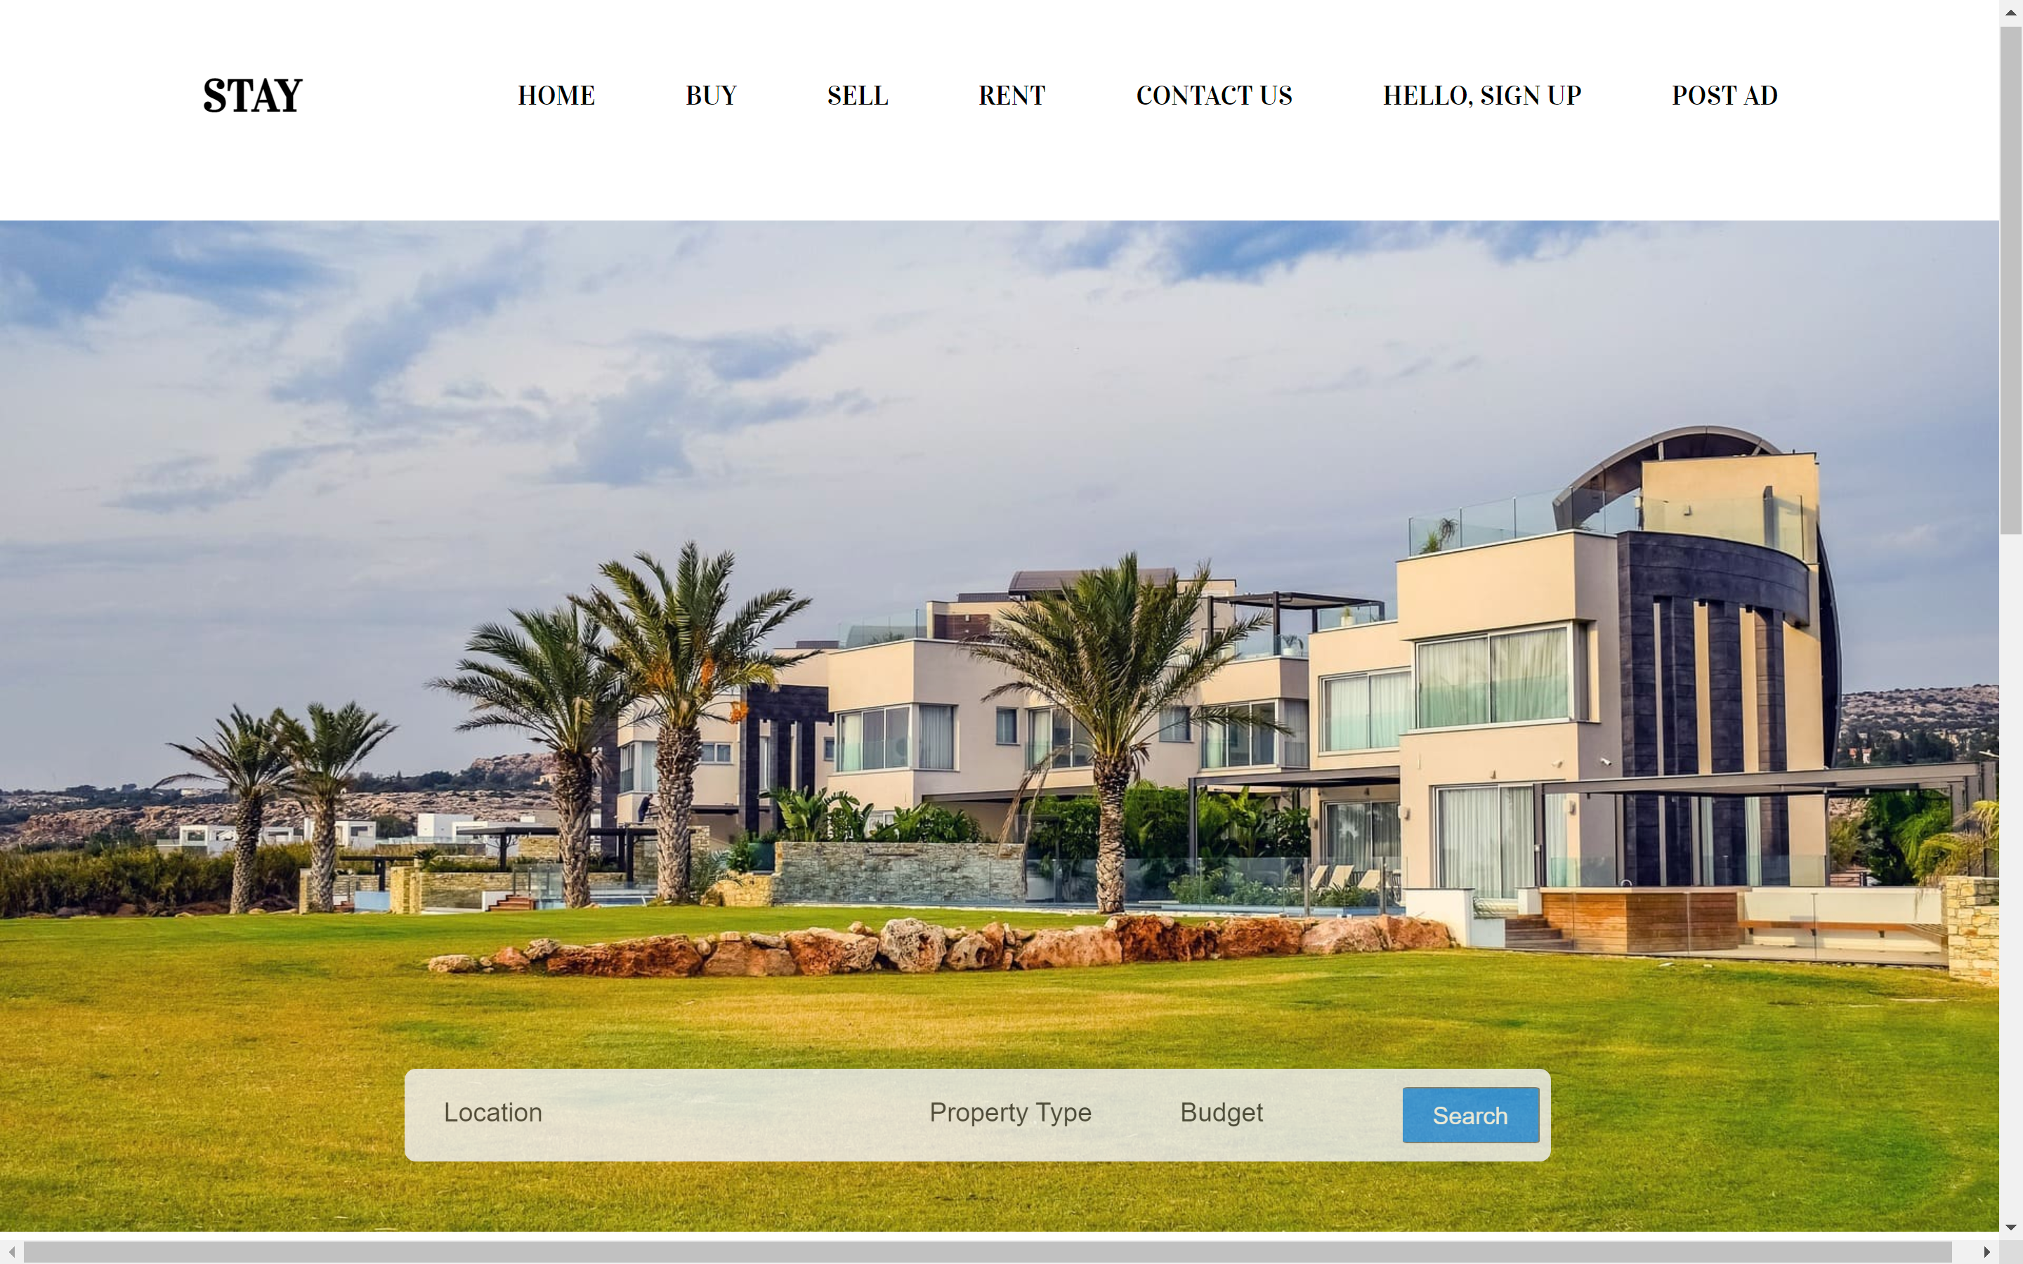
The home page
The Homepage consists of a Property Background and a Search bar with Location, Property Type and Budget inputs for the convenience of the user.
The Homepage is made attractive and clean so that the users can easily navigate around the webpage.

Slide 5
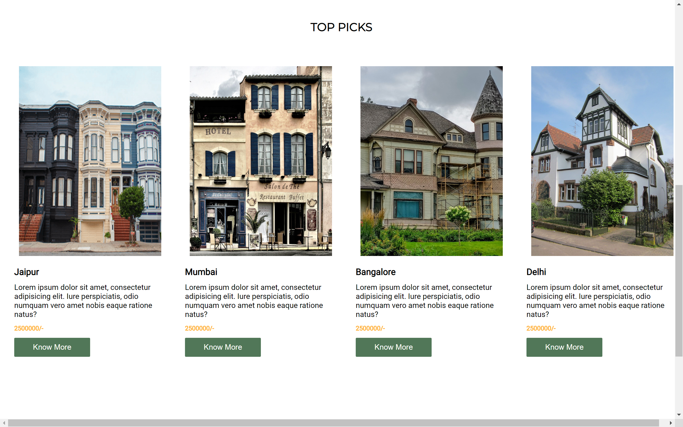

Slide 6

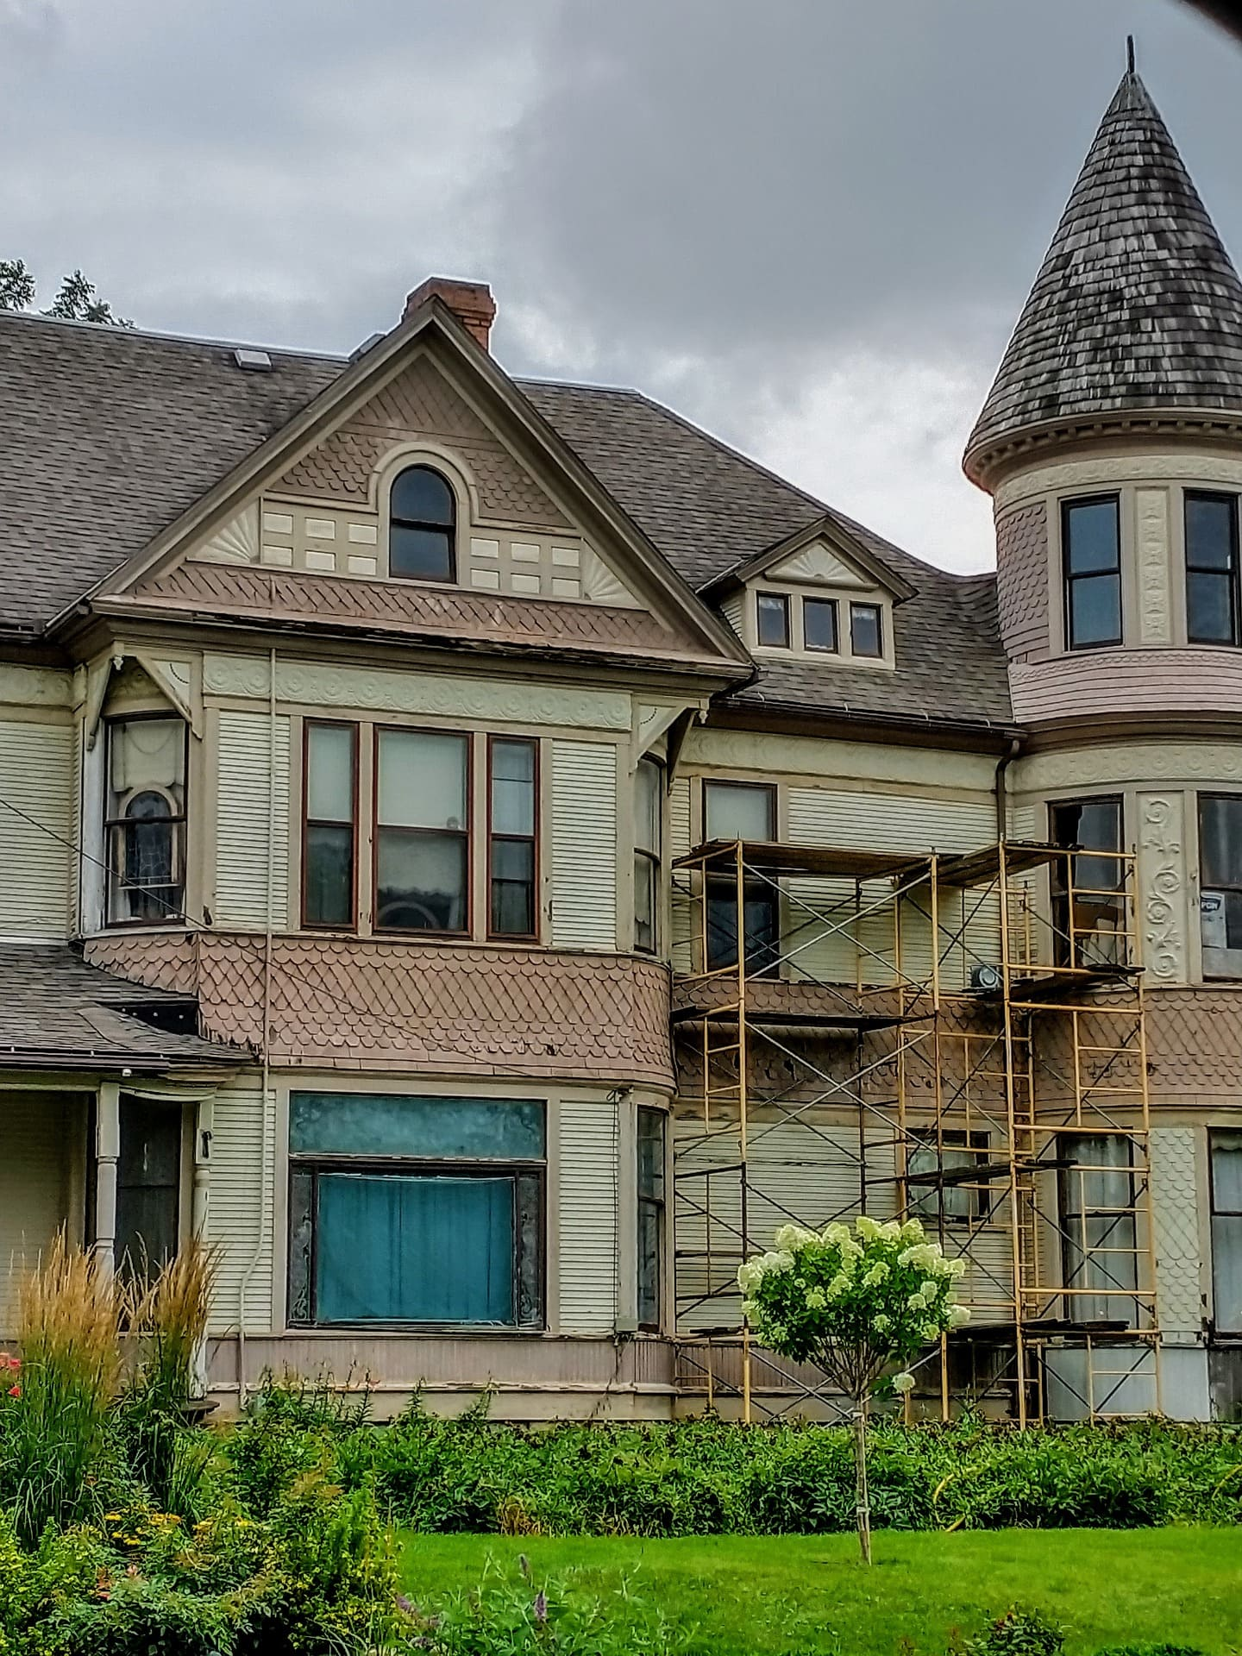
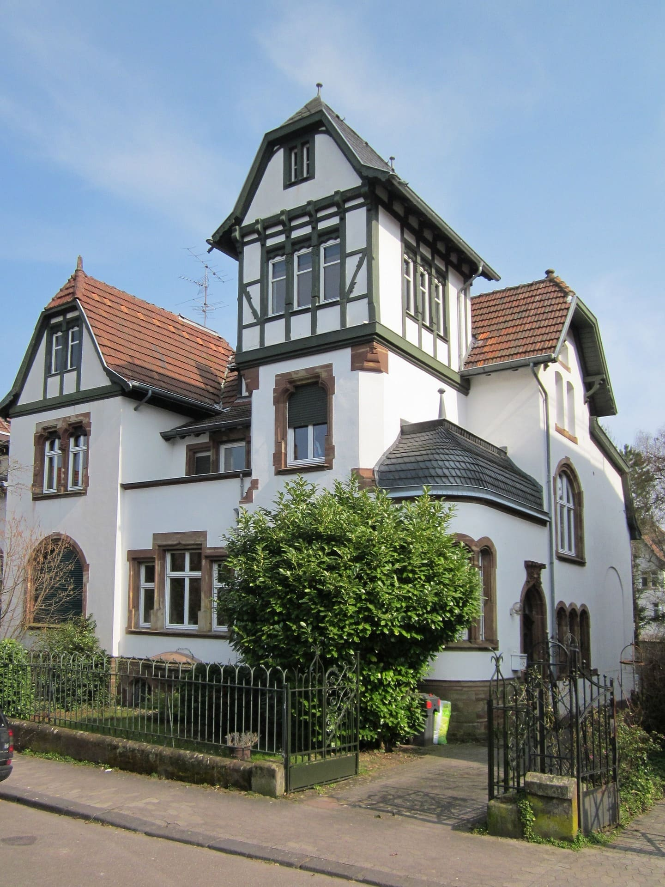
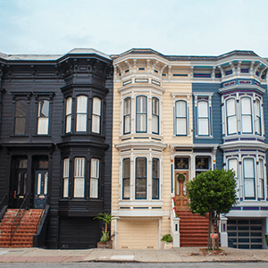
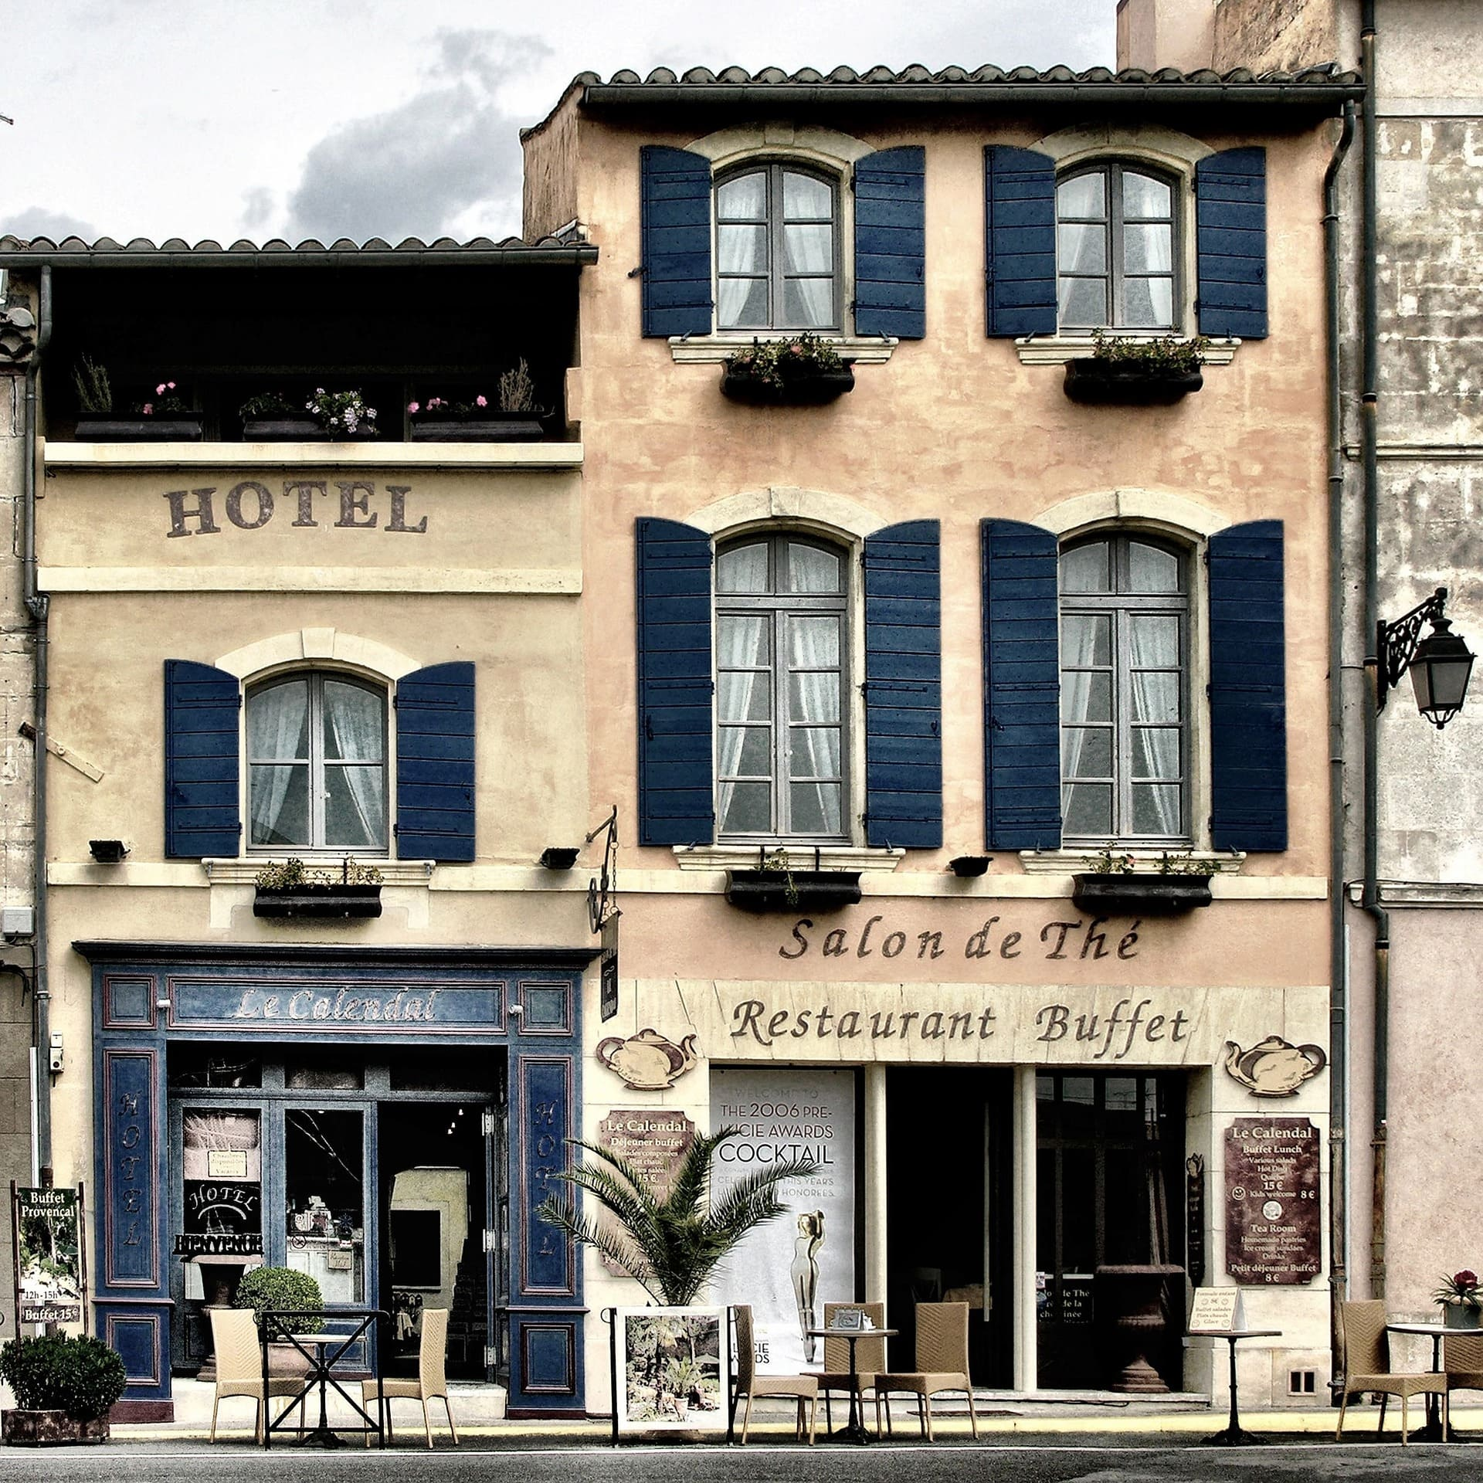
Gallery & TOP PIcks
A top picks section is added to the webpage to show case the best available properties to the users.

Slide 7
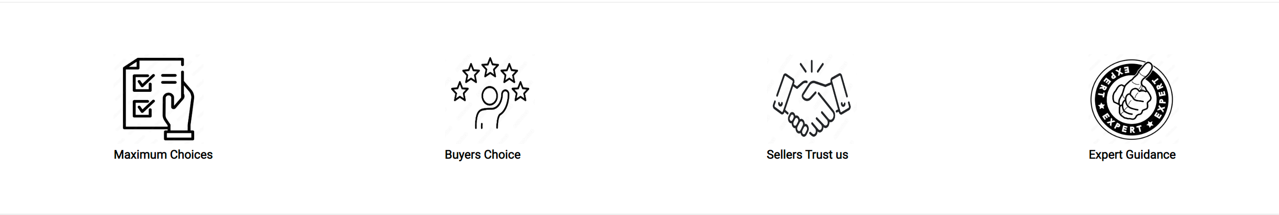
The footer:
Maximum Choices, Buyers Choices , Sellers Trust and Expert Guidance vector images are added at the end of the webpage to educate the user about the main qualities of the business.

Slide 8
Thank You

